Slide 1


Team 63: Arbitrary Waveform Generator
Bi-Weekly Update 3 Leandro Bracho, Nick Joseph, Oscar Medrano, Robin Smithson Sponsor: Dr. John Lusher TA: Zhewen Hu
Notes:
Michelle

Slide 2
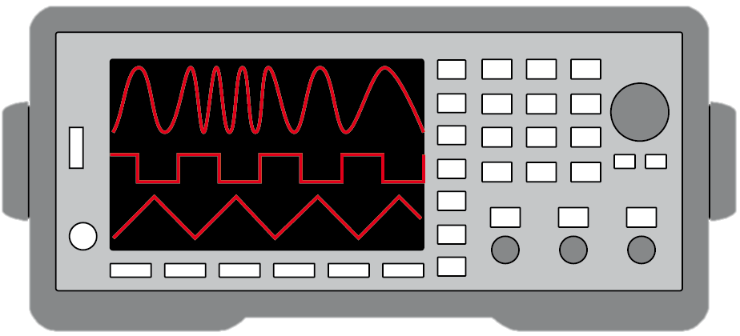
Project Summary
Problem Statement:
Test validation is a vital step in the design and fabrication of circuit boards for any project in the realm of electrical engineering.
Typical AWGs can be large and unintuitive
Solution Proposal:
Create a mobile user interface for the AWG
Bluetooth connection
Voltage range of +/- 10 V
Frequency between 1 Hz – 20 kHz
Maximum of 65,535 data points
Allow hand drawn waveforms
Notes:
Robin

Slide 3
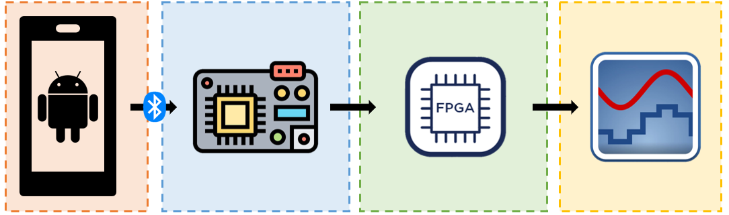
Project/Subsystem Overview
Diagram showing subsystems – with labels showing subsystem owners
Leandro Bracho | Robin Smithson | Nick Joseph | Oscar Medrano
Android Application | Microcontroller | FPGA | DAC
Notes:
Robin

Slide 4
Project Timeline
Update PCBs from feedback from last semester (completed 1/29) | Revalidate & Assess Subsystems (completed 2/5) | Order New PCBs (to complete by 2/16) | Integration of Subsystems (to complete by 3/4) | 3D Print Housing & Installation (to complete by 3/18) | Test & Validation (to complete by 4/8) | Demo and Report (to complete by 4/29)
Notes:
Leandro
Target or actual dates within or above boxes – green done, yellow underway, red in trouble, white not started
--
Save discussion for integration/test update
-- Save detail for execution plan & validation plan status

Slide 5
Android Application Leandro Bracho
Accomplishments since last update 10 hrs of effort | Ongoing progress/problems and plans until the next presentation
Stable connection with MCU Can transfer entire data point range GUI Improvements for exporting & connecting | Assist with PCB Soldering Research 3D Printed Housings
Notes:
For 3nd review Accomplishments should include what integration was completed and what functional system test (testing of what you integrated) has been completed. Include resolution of any KEY subsystem issues.
“Completed integration of MCU with Lidar camera”
“Completed testing of integrated motor controller and MCU for forward high speed and low speed and reverse movement”
“ON-GOING functional testing of complete system including vision system, navigation, obstacle avoidance, and object detection”
“Full system integration will be completed by next review”

Slide 6
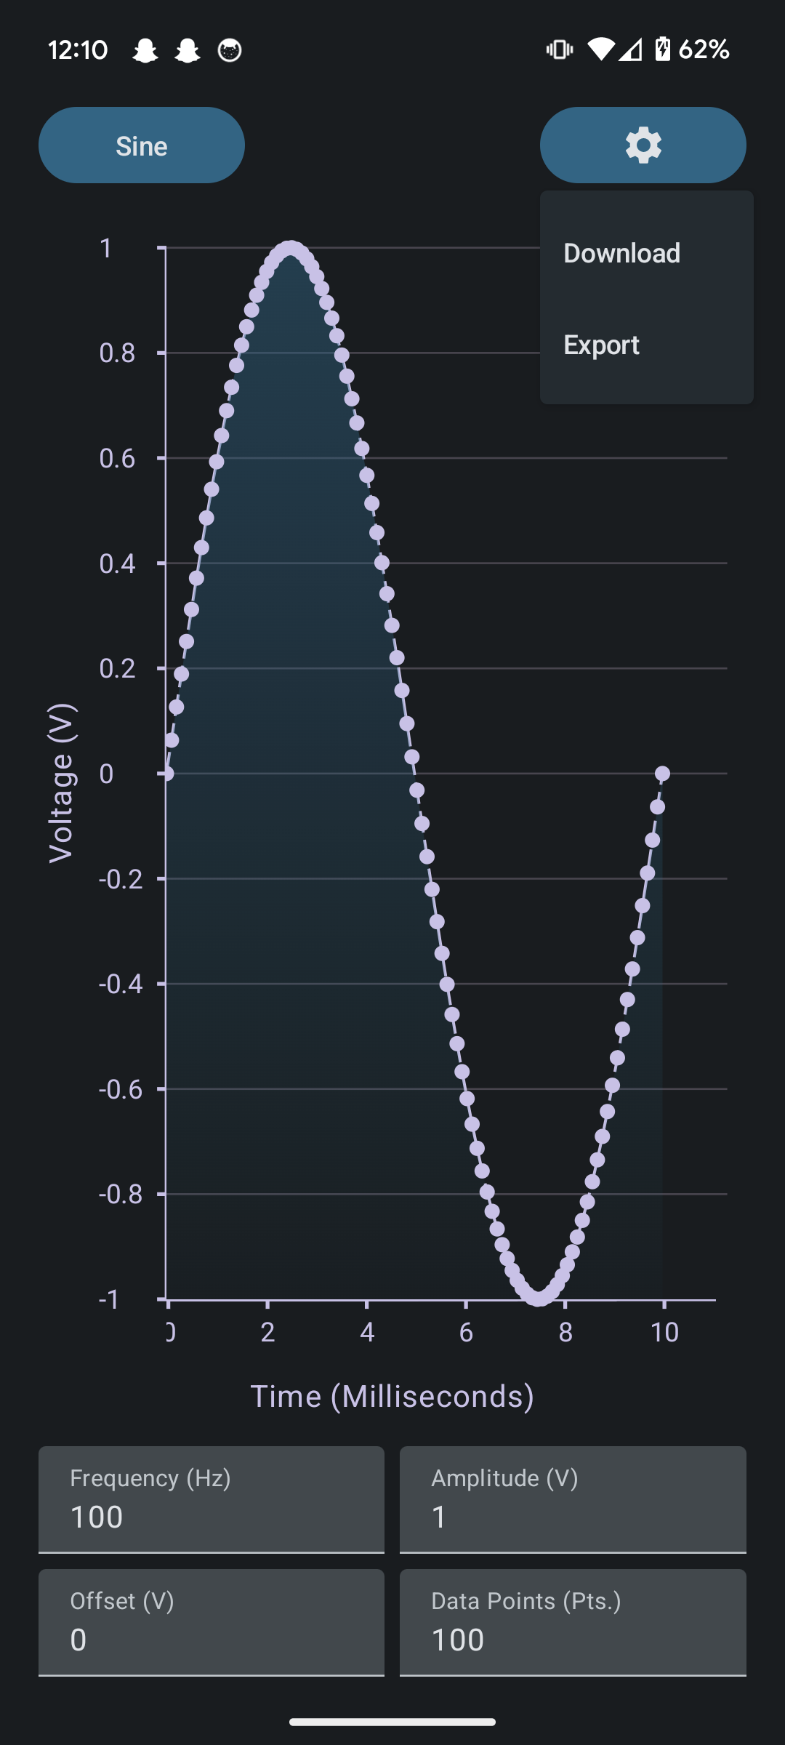
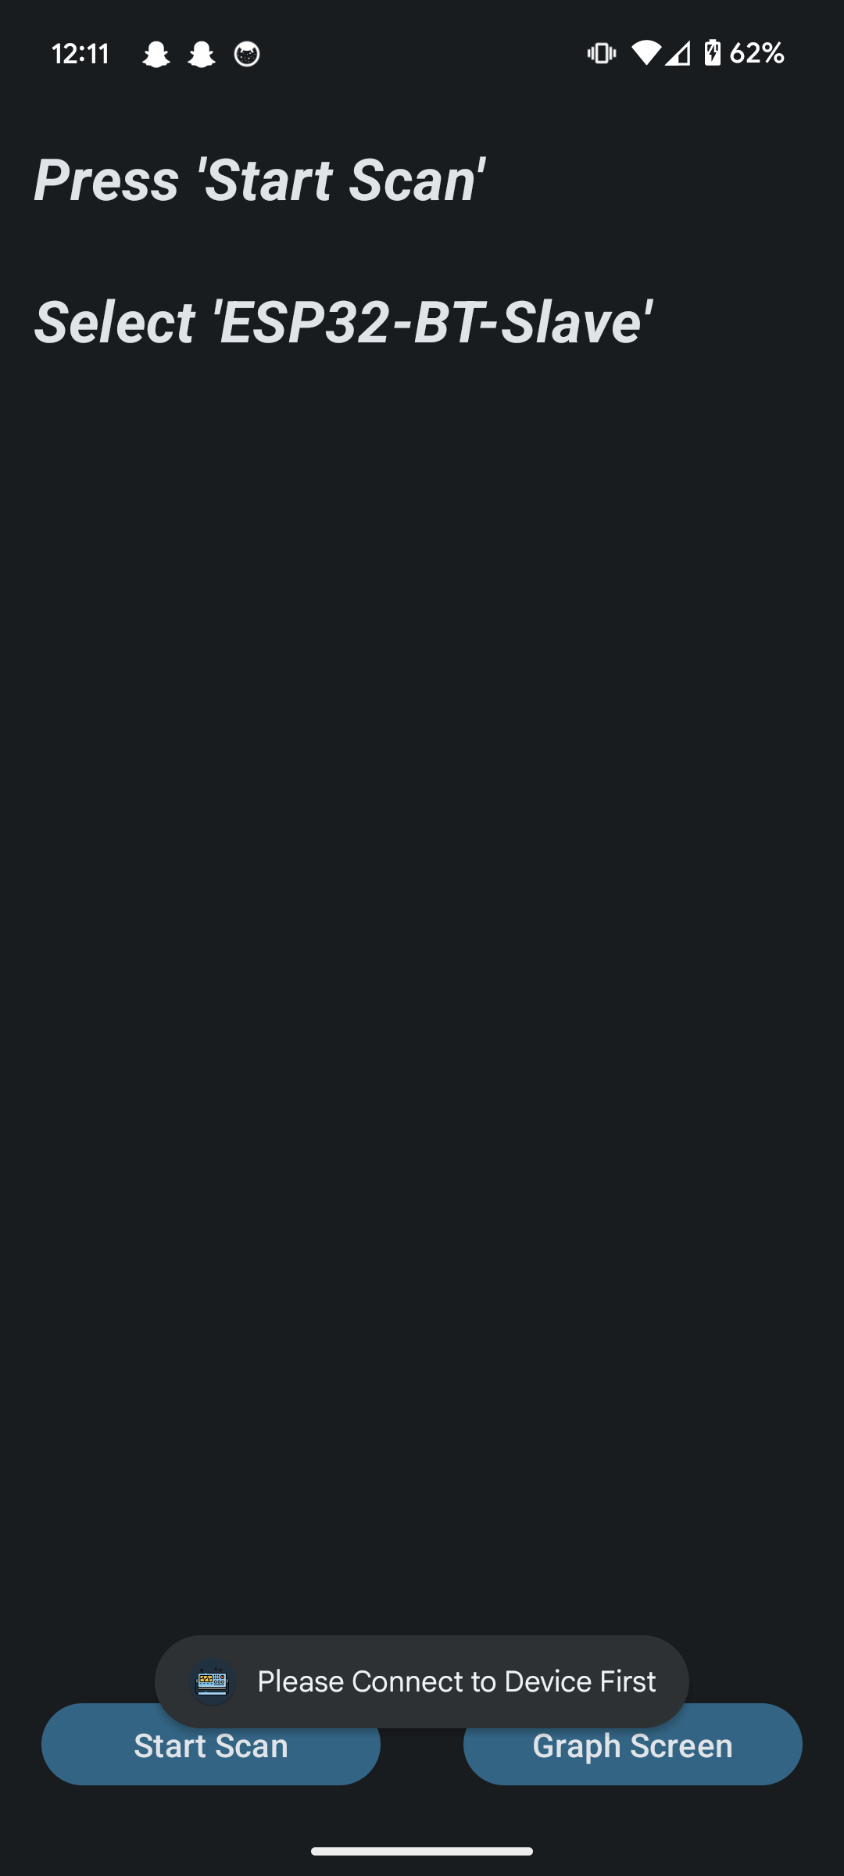
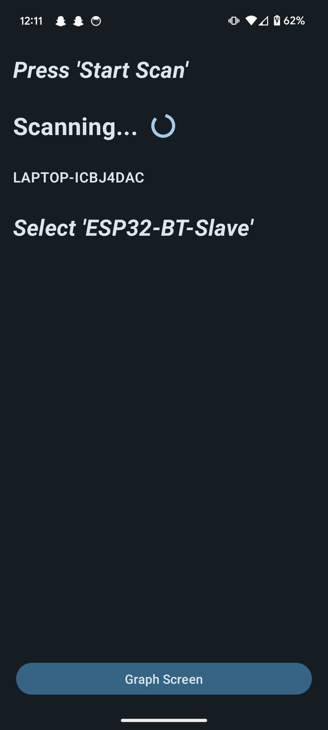
Android Application Leandro Bracho

Slide 7
MCU Robin Smithson
Accomplishments since last update 18 hrs of effort | Ongoing progress/problems and plans until the next presentation
PCB ordered and delivered 65,535 data points successfully imported to MCU | Solder components onto PCB Transfer code to new board Begin coding for transferring data to FPGA
Notes:
For 3nd review Accomplishments should include what integration was completed and what functional system test (testing of what you integrated) has been completed. Include resolution of any KEY subsystem issues.
“Completed integration of MCU with Lidar camera”
“Completed testing of integrated motor controller and MCU for forward high speed and low speed and reverse movement”
“ON-GOING functional testing of complete system including vision system, navigation, obstacle avoidance, and object detection”
“Full system integration will be completed by next review”

Slide 8
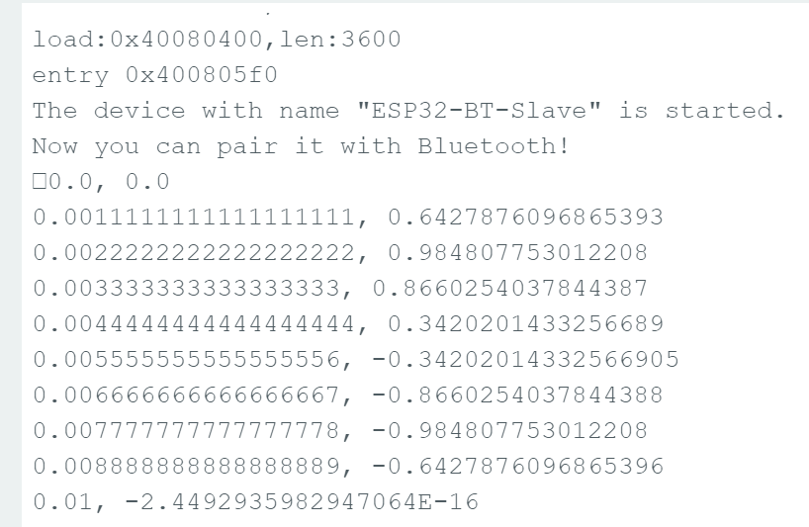
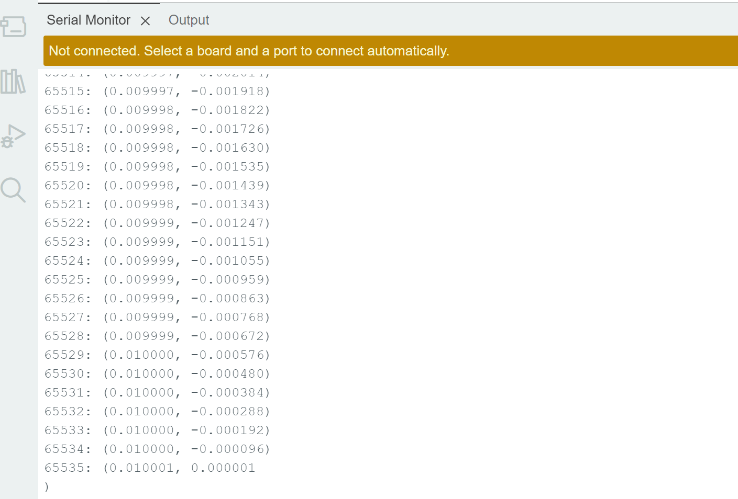
MCU Robin Smithson
Initial Data Transfer
Most Recent Data Transfer

Slide 9
FPGA Nick Joseph
Accomplishments since last update 20 hrs of effort | Ongoing progress/problems and plans until the next presentation
PCB has been ordered | Soldering the board Testing the board Integrating with the MCU Integrating with the DAC

Slide 10
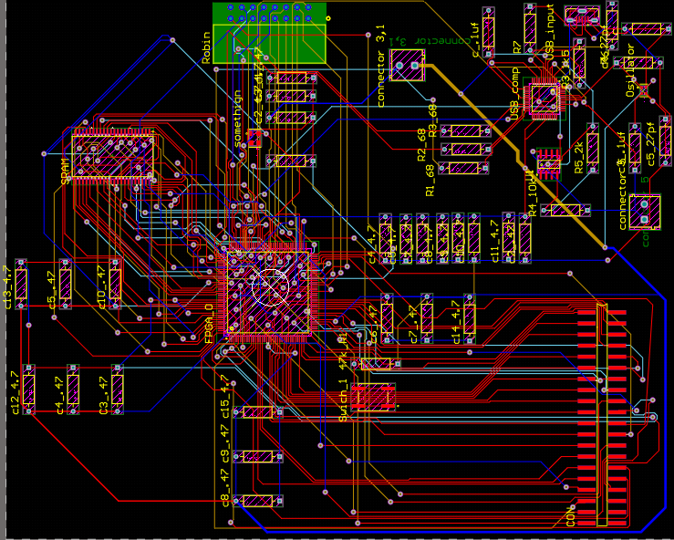
FPGA Nick Joseph
PCB Layout

Slide 11
DAC Oscar Medrano
Accomplishments since last update 10 hrs of effort | Ongoing progress/problems and plans until the next presentation
PCB routed and ordered | Solder PCB Test board Prepare integration with FPGA
Notes:
For 3nd review Accomplishments should include what integration was completed and what functional system test (testing of what you integrated) has been completed. Include resolution of any KEY subsystem issues.
“Completed integration of MCU with Lidar camera”
“Completed testing of integrated motor controller and MCU for forward high speed and low speed and reverse movement”
“ON-GOING functional testing of complete system including vision system, navigation, obstacle avoidance, and object detection”
“Full system integration will be completed by next review”

Slide 12
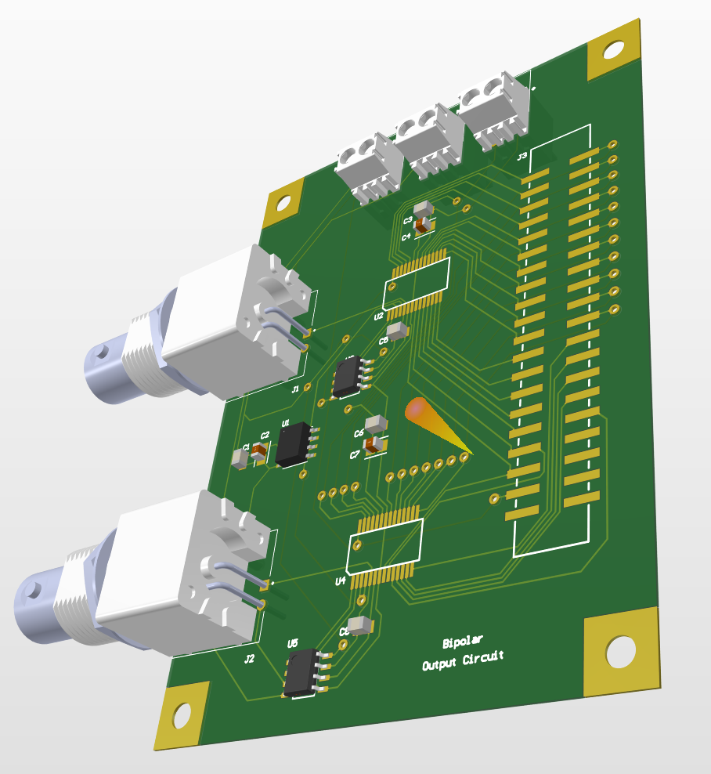
DAC Oscar Medrano
DAC System PCB

Slide 13
Power System Oscar Medrano
Accomplishments since last update 12 hrs of effort | Ongoing progress/problems and plans until the next presentation
Schematic design finished. | $90 for the system Routing the PCB Order the PCB by the end of the week. Solder and test the board the following week.
Notes:
For 3nd review Accomplishments should include what integration was completed and what functional system test (testing of what you integrated) has been completed. Include resolution of any KEY subsystem issues.
“Completed integration of MCU with Lidar camera”
“Completed testing of integrated motor controller and MCU for forward high speed and low speed and reverse movement”
“ON-GOING functional testing of complete system including vision system, navigation, obstacle avoidance, and object detection”
“Full system integration will be completed by next review”

Slide 14
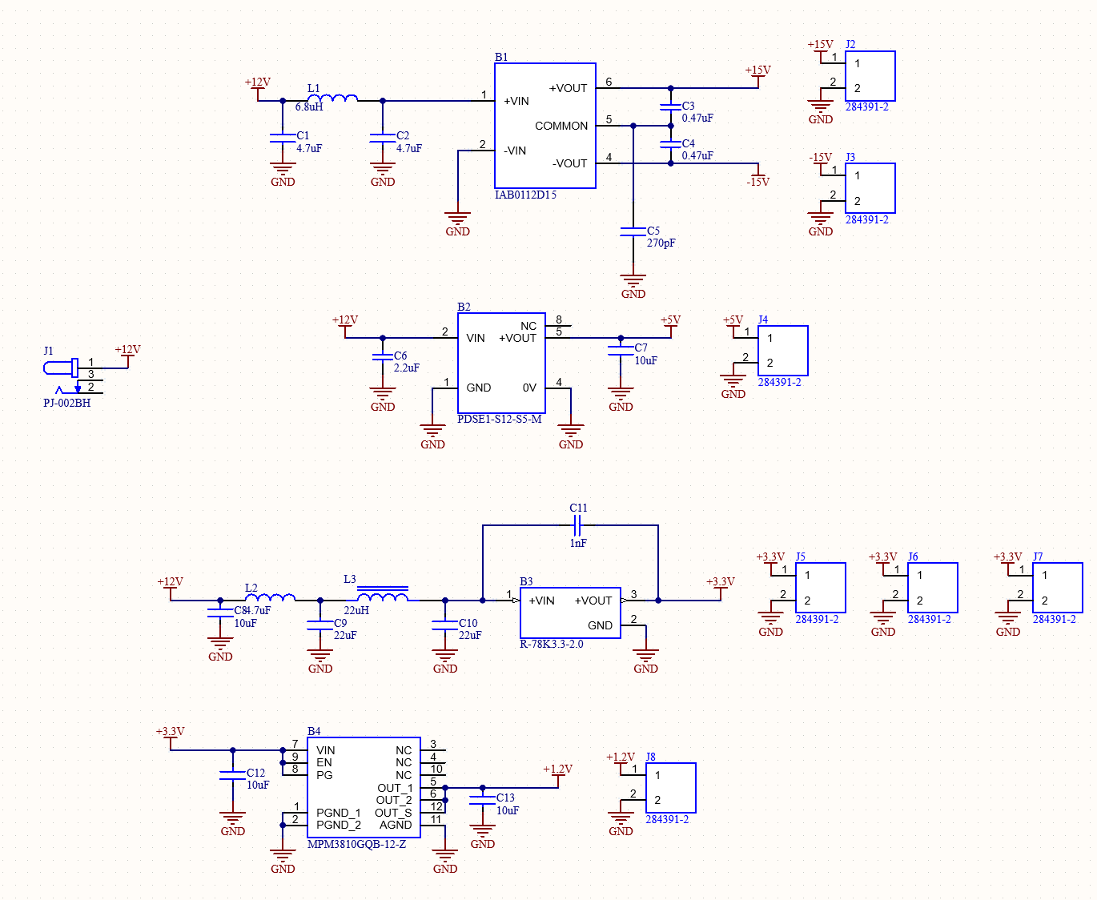
Power System Oscar Medrano
Power System Schematic

Slide 15
Execution Plan
 | Jan-22 | Jan-29 | Feb-5 | Feb-12 | Feb-19 | Feb-26 | Mar-4 | Mar-11 | Mar-18 | Mar-25 | Apr-1 | Apr-8 | Apr-15 | Apr-22 | Apr-29
Andriod Application
Assess Current Application Status |  |  |  |  |  |  |  |  |  |  |  |  |  |  |  |  | Not Started
Improve Bluetooth Scan |  |  |  |  |  |  |  |  |  |  |  |  |  |  |  |  | In Progress
Pair & Connect Via Bluetooth |  |  |  |  |  |  |  |  |  |  |  |  |  |  |  |  | Completed
Transfer Data Via Bluetooth |  |  |  |  |  |  |  |  |  |  |  |  |  |  |  |  | Behind Schedule
UI Improvements
Microcontroller
Edit MCU Schematic
Program Bluetooth Connection
Import Data
Export Data
FPGA
Redesign FPGA board
Solder New Board
Test System
First Integration
Fixing Integration Issues
DAC & Power System
Schematic Design (DAC)
Schematic Design (Power Sys)
Order New Parts
Solder Boards
Test DAC System
Test Power System
 | Jan-22 | Jan-29 | Feb-5 | Feb-12 | Feb-19 | Feb-26 | Mar-4 | Mar-11 | Mar-18 | Mar-25 | Apr-1 | Apr-8 | Apr-15 | Apr-22 | Apr-29
Project Introduction Presentation
Project Update (1) Presentation
Project Update (2) Presentation
Project Update (3) Presentation
Project Update (4) Presentation
Final Presentation
Project Demo
Final Report
Integration
Power System Designed
App and MCU Connection
Complete PCB Schematic
Final PCBs Ordered
Parts Still Needed Ordered
Final PCBs Soldered
Debugging and Testing
Final System Adjustments
Notes:
Michelle
Execution plan
Your team planned milestones for completion of any remaining integration of specific subsystems, functional test, and validation plans should be presented.
Milestones should have owners … functional system testing, and full system integration can be group owned
Gantt chart.

Slide 16
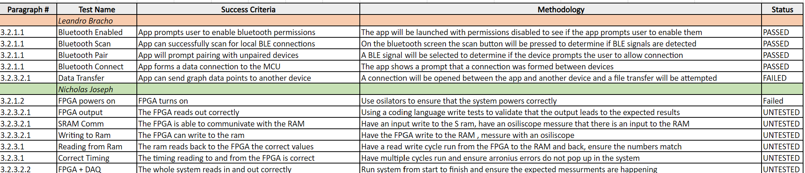
Validation Plan
Notes:
Michelle

Slide 17
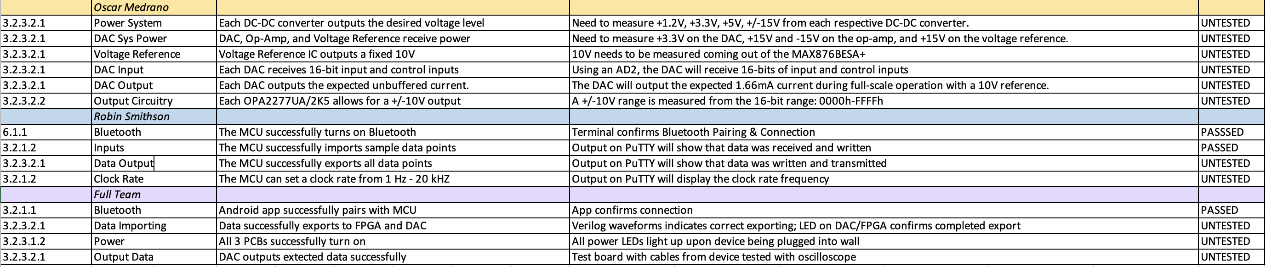
Validation Plan
Notes:
Michelle

Slide 18
Thank you

